Slide 1
NWTEMC Communications Interoperability Exercise
CDR Steve McLaughlin USN (ret)
T.J. Harmon CEM

Slide 2
ICEBREAKER!
By the time this exercise is over, we might need an icebreaker!

Slide 3
Exercise Objectives
Define communications interoperability
Review H1N1 precautions
Identify procedures for tracking an H1N1 outbreak across a wide area
Determine NWTEMC communications procedures necessary during a wide-area emergency and identify current challenges to NWTEMC communications processes
Identify gaps/seams in current communications processes and document those gaps/seams

Slide 4
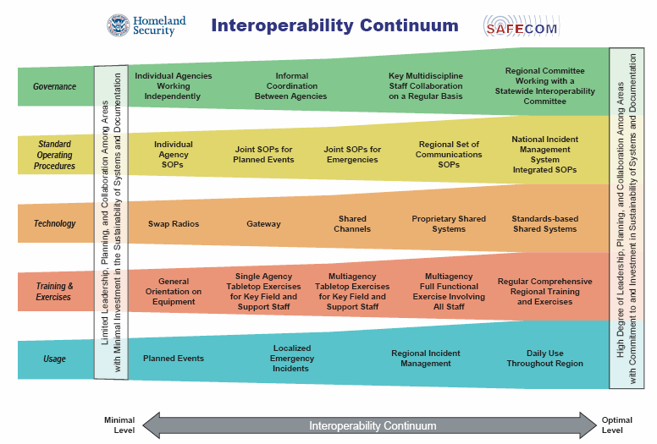

Slide 5
Discussion Question:
What is communications interoperability?
What are the necessary components of interoperability?
Is it all about the gear? Is there more?

Slide 6
Remember Together?
Talk
Overview
Get Protocols
Engage
Technology
Help learn
Exercise
Ready
Get to know your neighbors
Define region interoperability
Develop protocols
Sign Agreements
Coordinate technology
Provide training
Perform testing

Slide 7
Scenario: H1N1 Outbreak
15 November: While many health care workers in urban areas have received the H1N1 vaccination, there is still a lack of vaccine required to treat the general population.
22 November: H1N1 outbreaks begin in tribal schools and resorts
30 November: 450 cases of H1N1 are reported in tribal areas within the NWTEMC region and 2500 cases are reported in Washington and Northern Idaho

Slide 8
Discussion Questions
Who do we report H1N1 outbreaks to?
What measures do we take to report outbreaks?
What communications methods are used?
How do we communicate information to tribal members?
How do we communicate information to the general public (casino patrons etc.)?

Slide 9
Is there a Doctor in the House?!?
Let’s review precautions that may help prevent the spread of H1N1 and other viruses

Slide 10
Scenario
It is December 5, 2009. The National Weather Service is predicting a very large low pressure center will drop down from Canada and settle over Central Washington. A second, wet, cold front is moving into the Pacific Northwest. Forecasters are expecting HEAVY Snows across the region. Coastal Washington and the Puget Sound are expecting a record 3 feet of snow. The inland areas should see blizzard conditions and up to 4 feet of snow with heavy drifting.

Slide 11
Discussion Question
What communications preparations will you make as you prepare for this storm?
What agencies will your tribe be required to work with during this storm?
What interoperability agreements are in place with those agencies?
Mutual Aid? What’s that?

Slide 12
Mutual Aid
Agreements between jurisdictions, agencies or governments to support each other in a variety of contingencies.
Normally, mutual aid agreements are part of the planning process BEFORE an incident occurs.
What mutual aid agreements does your tribe have in place?

Slide 13
Here it Comes!
5 p.m. on December 6:
Temperature in Seattle: 29 degrees and snowing at rate of 2”/hour; winds from NW at 18 mph
Temperature in Yakima: 27 degrees and snowing at rate of 1.5”/hour; winds from N at 22 mph
Temperature in Spokane: 18 degrees and just starting to snow; winds from NE at 18 mph
WA STATE EOC ACTIVATES! NWTEMC ACTIVATES!

Slide 14
8 a.m. December 7
Temperature in Seattle: 27 degrees and snowing at rate of 3”/hour; winds from NW at 25 mph; total snowfall last 24 hours 16 inches
Temperature in Yakima: 14 degrees and snowing at rate of 3”/hour; winds from N at 22 mph; total snowfall last 24 hours 14 inches, drifts
Temperature in Spokane: 10 degrees and snowing at rate of 2.5”/hour; winds from NE at 24 mph; total snowfall 18 inches, drifts

Slide 15
Situation: 8 a.m. December 7
Seattle: Plows cannot keep up with snowfall; widespread power outages. Hundreds of fallen trees across power lines
Yakima: Blowing snow reduces visibility to zero; drifts up to 12 feet high barricade most highways, streets and roads. Power is out to 50% of area
Spokane: Same as Yakima but temperatures plummet to close to 0 degrees.

Slide 16
Discussion Questions
How do emergency responders communicate with supporting agencies in this situation? Can you?
How do you report your situation to NWTEMC EOC? Can you?
Do you have emergency power generation capability?
HAM network operable?
What is the power restoration priority in your area? How does it affect your ability to communicate in your tribal area? With NWTEMC?
Do you have a back-up? 2-way handhelds, etc?

Slide 17
Situation: 5 p.m. December 7
A strong Polar cold front has moved into the region. Temperatures for the next 14 days will be:
Seattle: Max high will be 22 degrees
Yakima: Max high will be 10 degrees
Spokane: Max high will be 5 degrees
There continues to be widespread power outages throughout the region but your EOC has power.

Slide 18
Discussion Questions?
Now that you have power, what are your communications priorities?
  Tribal members?
  County or State EOC?
  NWTEMC EOC?
Identify the communications equipment you will have available to accomplish your reporting priorities.

Slide 19
Discussion Question
What are the strengths of your communications plan?
What are the weaknesses?
What mutual aid agreements do you have in place? With whom?
What improvements would you like to see in your communications plan?
  Training?
  Agreements?
  Equipment?
Please record your tribal POC/email/phone

Slide 20
Wrap-up
NWTEMC Communications Director: Arlen Moses
Training: Steve McLaughlin and TJ Harmon
Public Outreach in Washington: Laura Kingman
Does all the work: Glenn Coil
THANK YOU!

